Slide 2
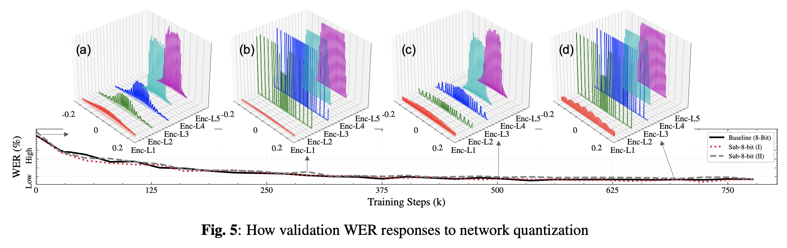
Sub-8-bit QAT
With a periodic hard compression in (b), weights are closer to their centroids in (C)
The hard compression in (d) causes less degradation than (b) thanks to QAT
Notes:
Qat after a fully trained model?
One cycle learning rate scheduler (all of a sudden jump to a high level)
Differentiate 8-bit performance wise.
Solves the failure case of the previous paper.
Sub-8-bit in l1 is confusing.

Slide 3
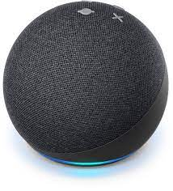
Sub-8-bit Quantization in Production
Employed in our recent BlueBottle production model (R15), and subsequent model releases
BlueBottle Model | WER |  |  | UPL | Parameters
 | en_US_glidepath | alexa_rare_words | contact_name | P50
R13/14 | 1 | 2.253 | 1.294 | 1 | 66.6M
R15 (in sub-8-bit) | 0.940 (-6.41%) | 2.103 (-7.12%) | 1.098 (-17.78%) | 0.915 (-8.5%) | 74.4M (+11.7%)

Slide 4
How to use it in future model releases
Suppose it’s RNN-T for now
Train a FP baseline model
Run K-means clustering algorithm on each kernel
Design kernel-specific 5-bit regularizers
https://code.amazon.com/packages/Phasa/blobs/alpha/--/src/phasa_asr/experimental/compressing_scheduler_example/common_configs_5bit.py

Slide 5
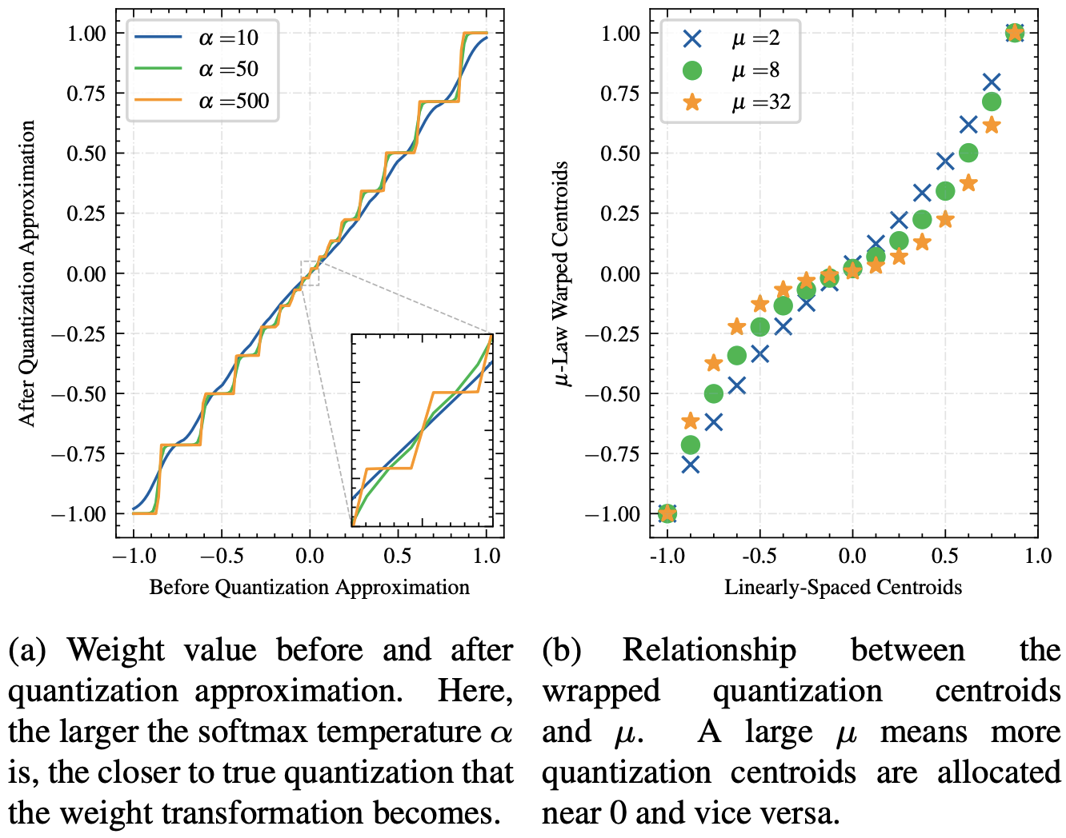
General Quantizer: A Regularization Free Approach
Annealing temperature and non-linear factor
AHS Q3 Summit

Slide 6
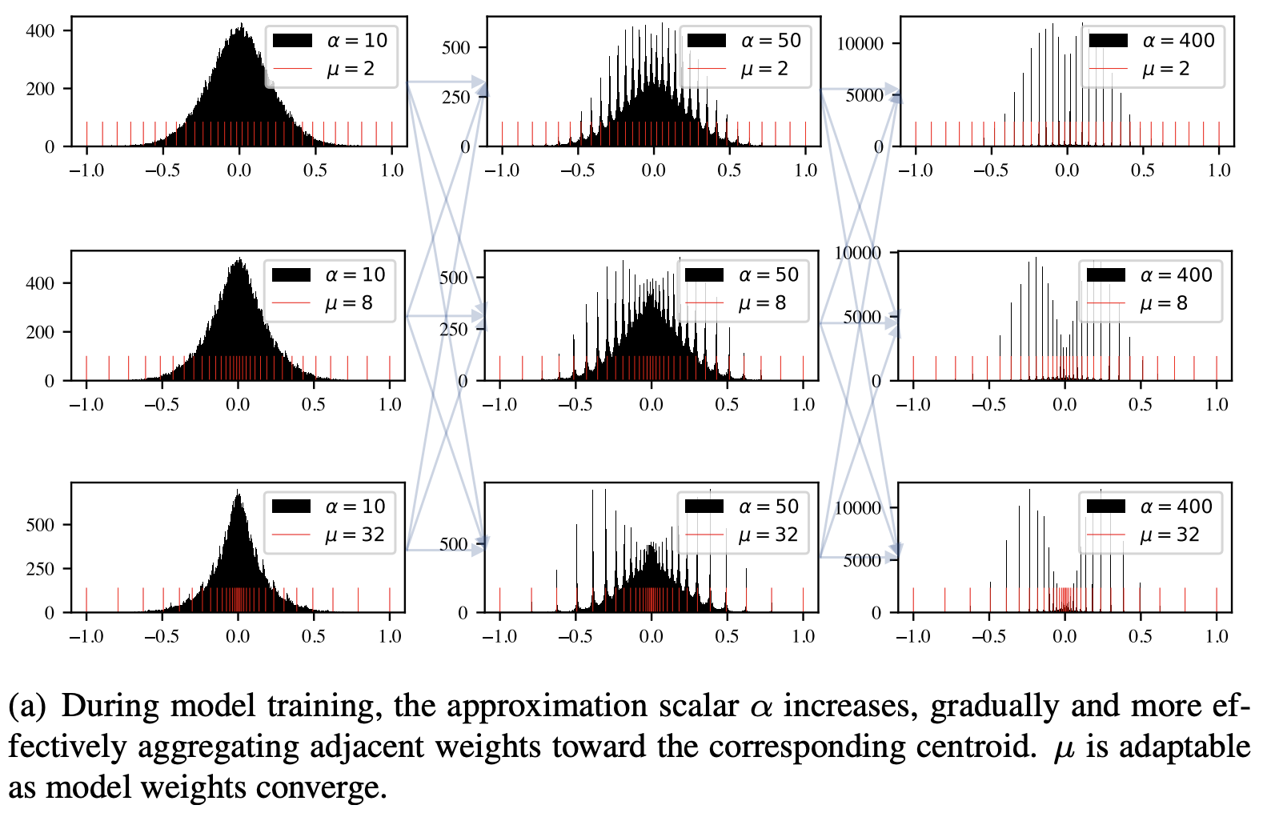
General Quantizer (GQ): A Regularization Free Approach
Annealing temperature and non-linear factor
AHS Q3 Summit

Slide 7
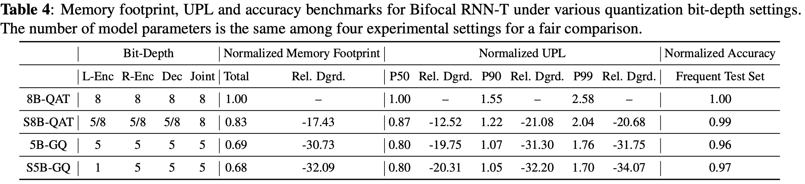
Sub-5-bit RNN-T with GQ

Slide 8
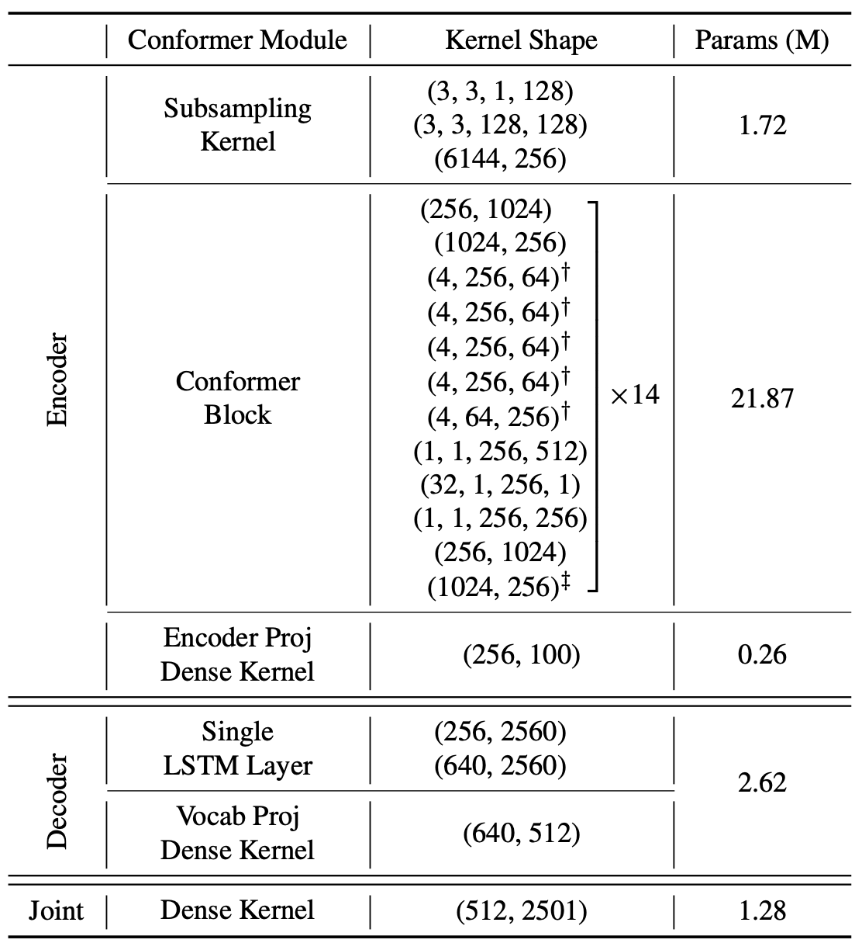
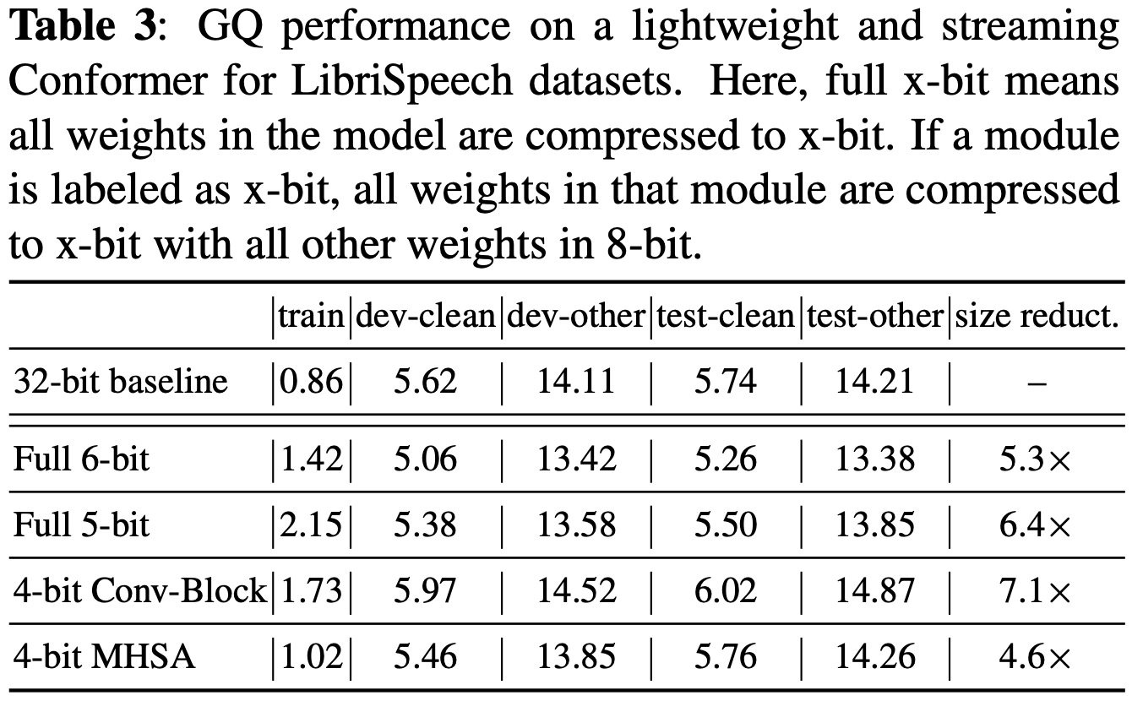
4-bit Conformer with GQ

Slide 9
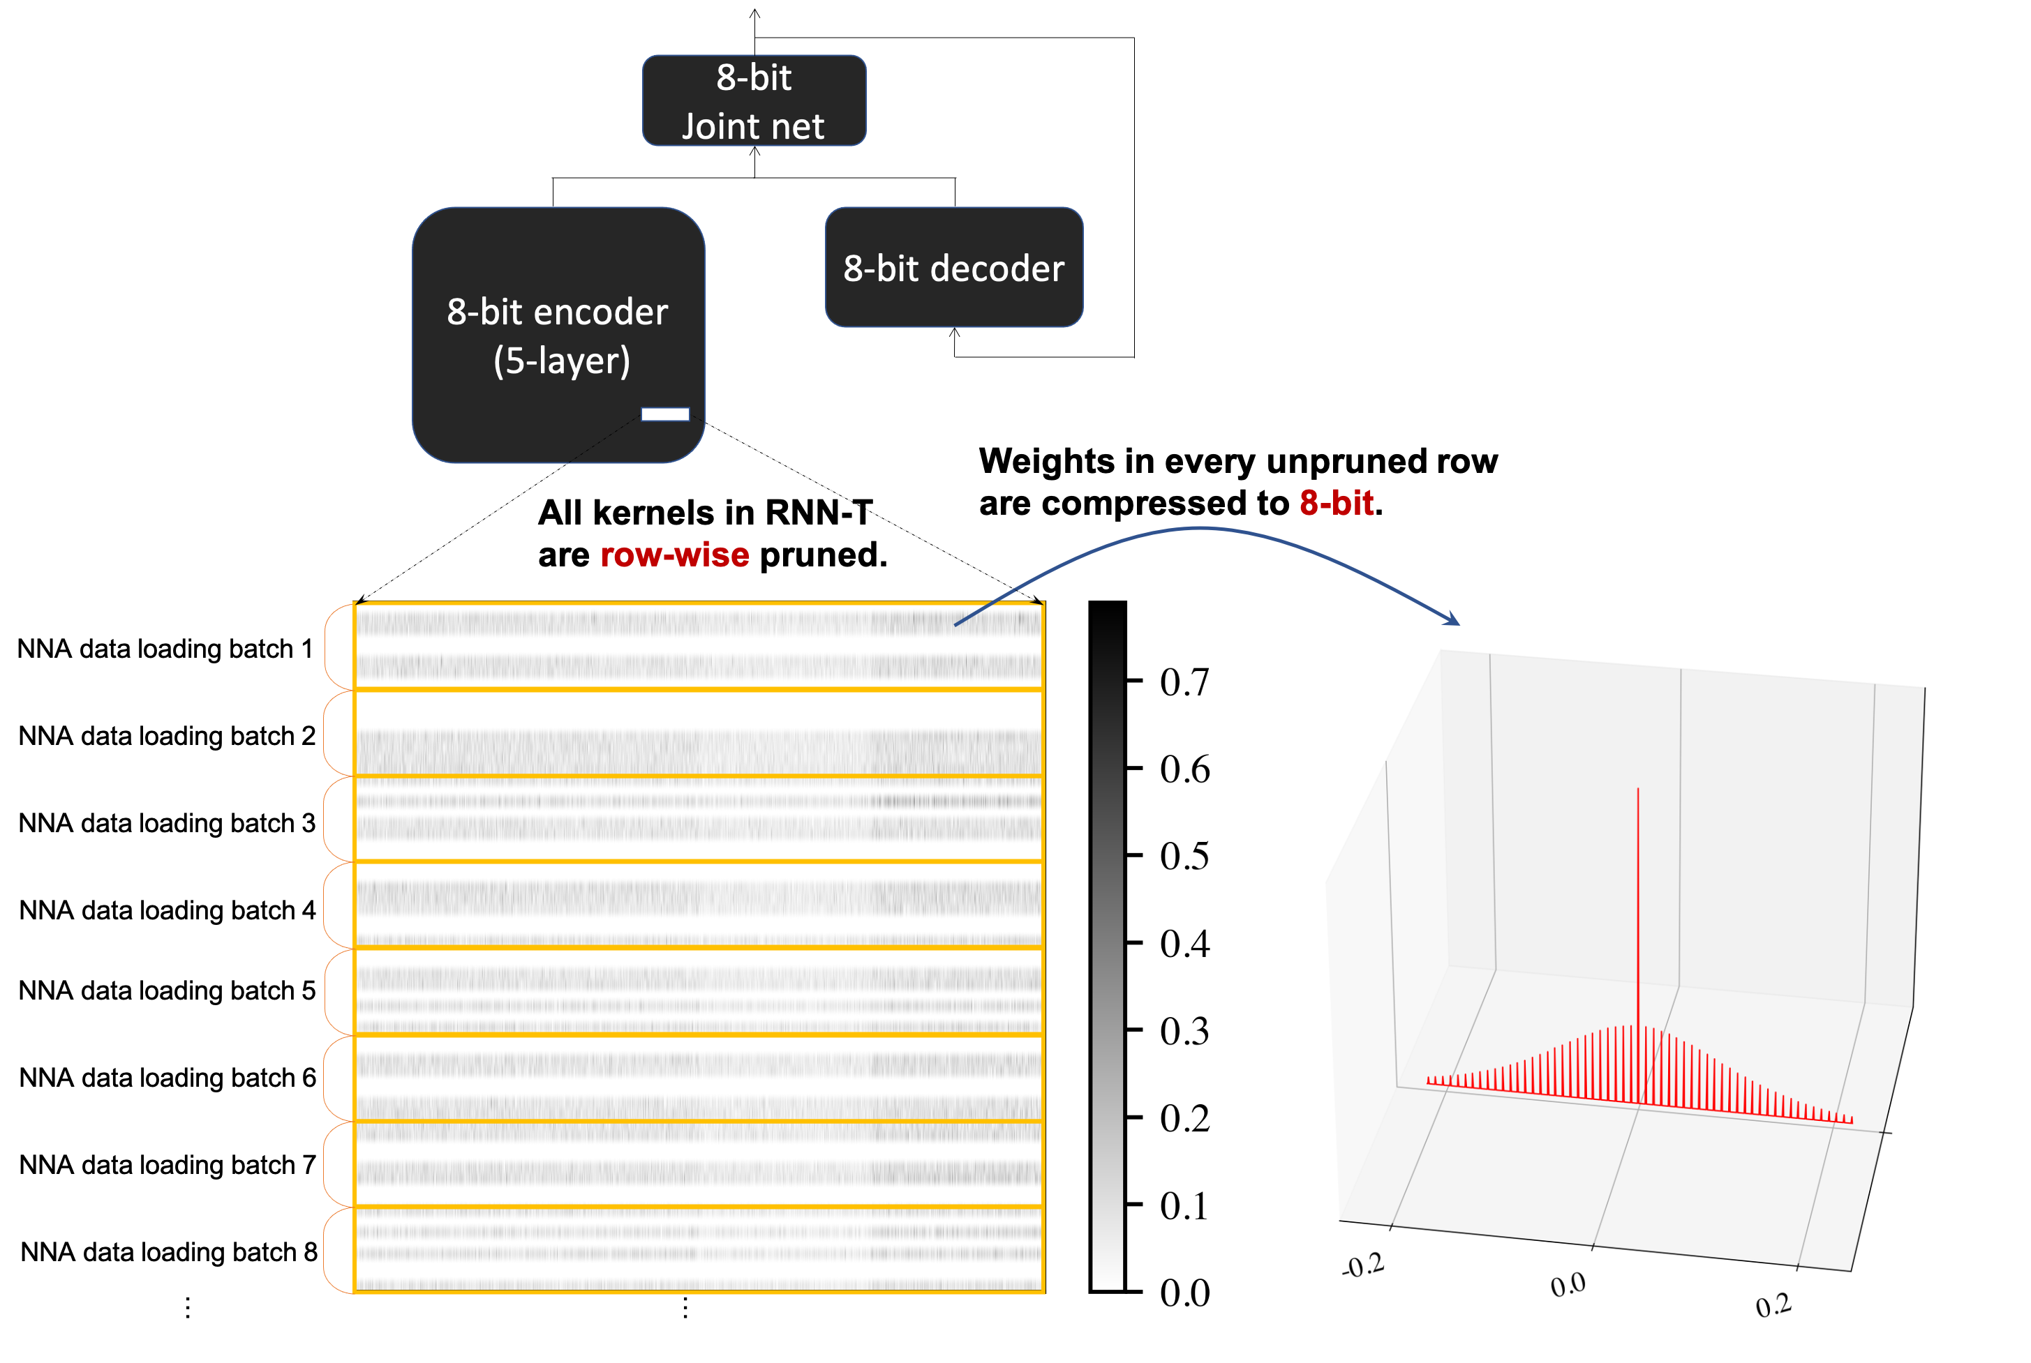
Neural Sparsification
Lowering UPL for both on-device and cloud ASR
We are aimed to train a sparse RNN-T with no degradation in which
x out of 8 consecutive rows in any kernels are completely pruned (x could be 1, 2, 3 or even 4);
unpruned rows are 8-bit quantized.

